Slide 1
pAInball
Creating an AI to play Pinball
Spiros Bontomitsidis
L-IN | E-M
May 31st ‘24

Slide 2
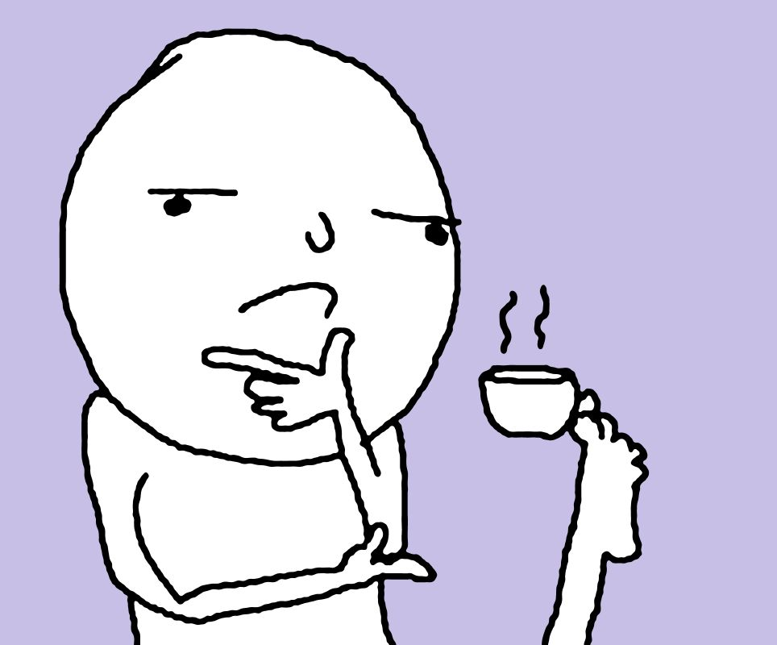
The “problem” (and the motivation)
How can I learn about ML and Neural Networks...
...while I play video games?

Slide 3

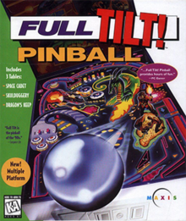
The Game: Space Cadet
Win95 and XP: 3D Pinball
Developed by: Cinematronics/Maxis
Decompiled! Source available

Slide 4

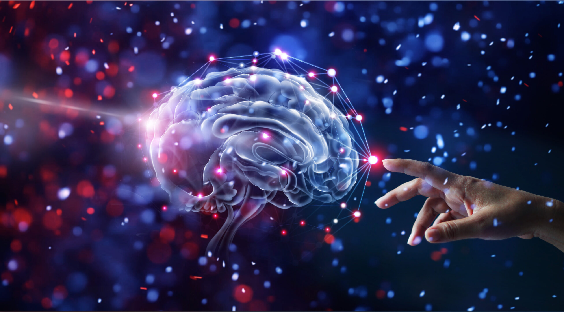
The AI: Training approach
Option 1: Teacher
Record my gameplay
Supervised Learning
Gradient decent
Back propagation
Option 2: God
I make the rules!
Genetic Algorithm: NEAT
NeuroEvolution
Imitates natural selection
Notes:
What application is neat used for in the life of people who try to be useful – specifically to save the planet

Slide 5
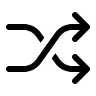
The AI: “Compete–Kiss–Repeat” TM
Generation of N Players
Mate the k best
Make 1 child (Crossover)
N new Children (Mutations)
Parent 1
Seed Child
*
Parent 2
Mutations
Seed Child
Fitness
Crossover
Fitness
Repeat
*Random icons created by th studio - Flaticon
Notes:
k can also be =1

Slide 6
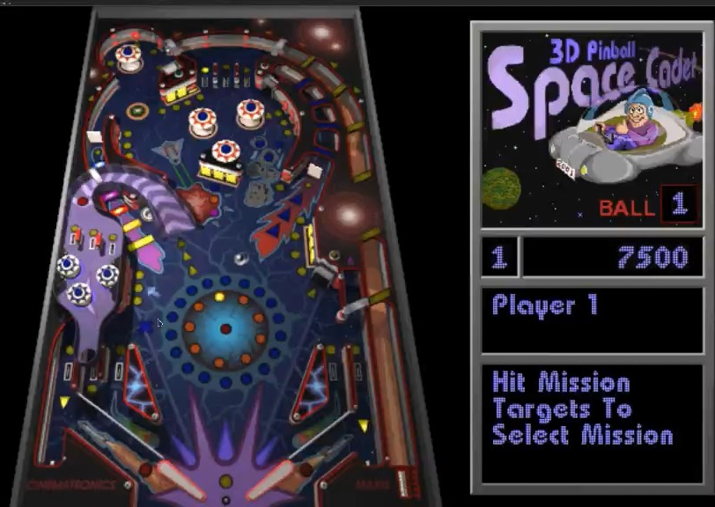

The AI: Game Outputs
For NN Inputs:
Position (X,Y)
Speed (V)
Direction (Vx,Vy)
For Fitness:
X
Score
Vx
Y
Lost Balls
|V|
Ball Hits Left
Vy
Ball Hits Right

Slide 7
The AI: NN Outputs
Do nothing
Left Hit
Right Hit

Slide 8
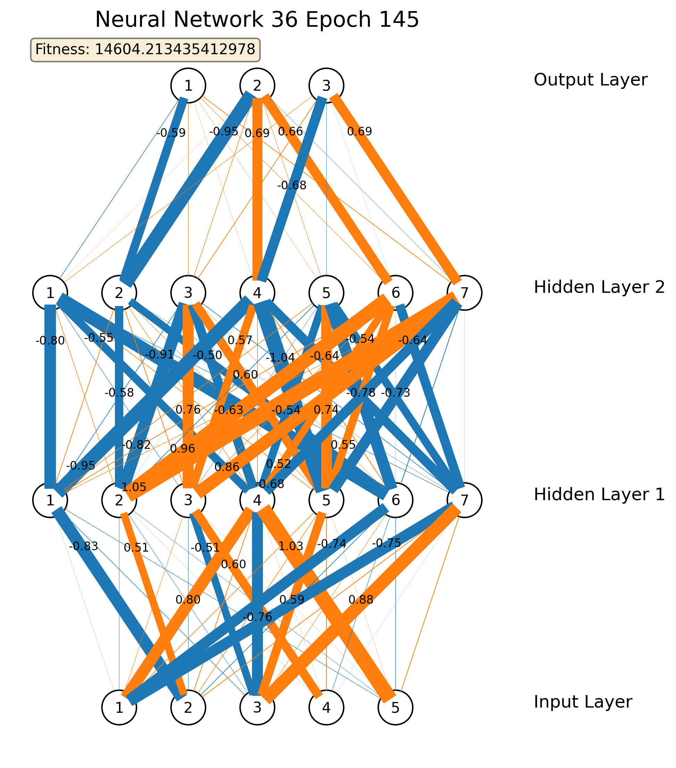
Final NN Shape
1-No Action 2-Left Hit 3-Right Hit
1-Speed 2-PosX 3-PosY 4-DirX 5-DirY

Slide 9
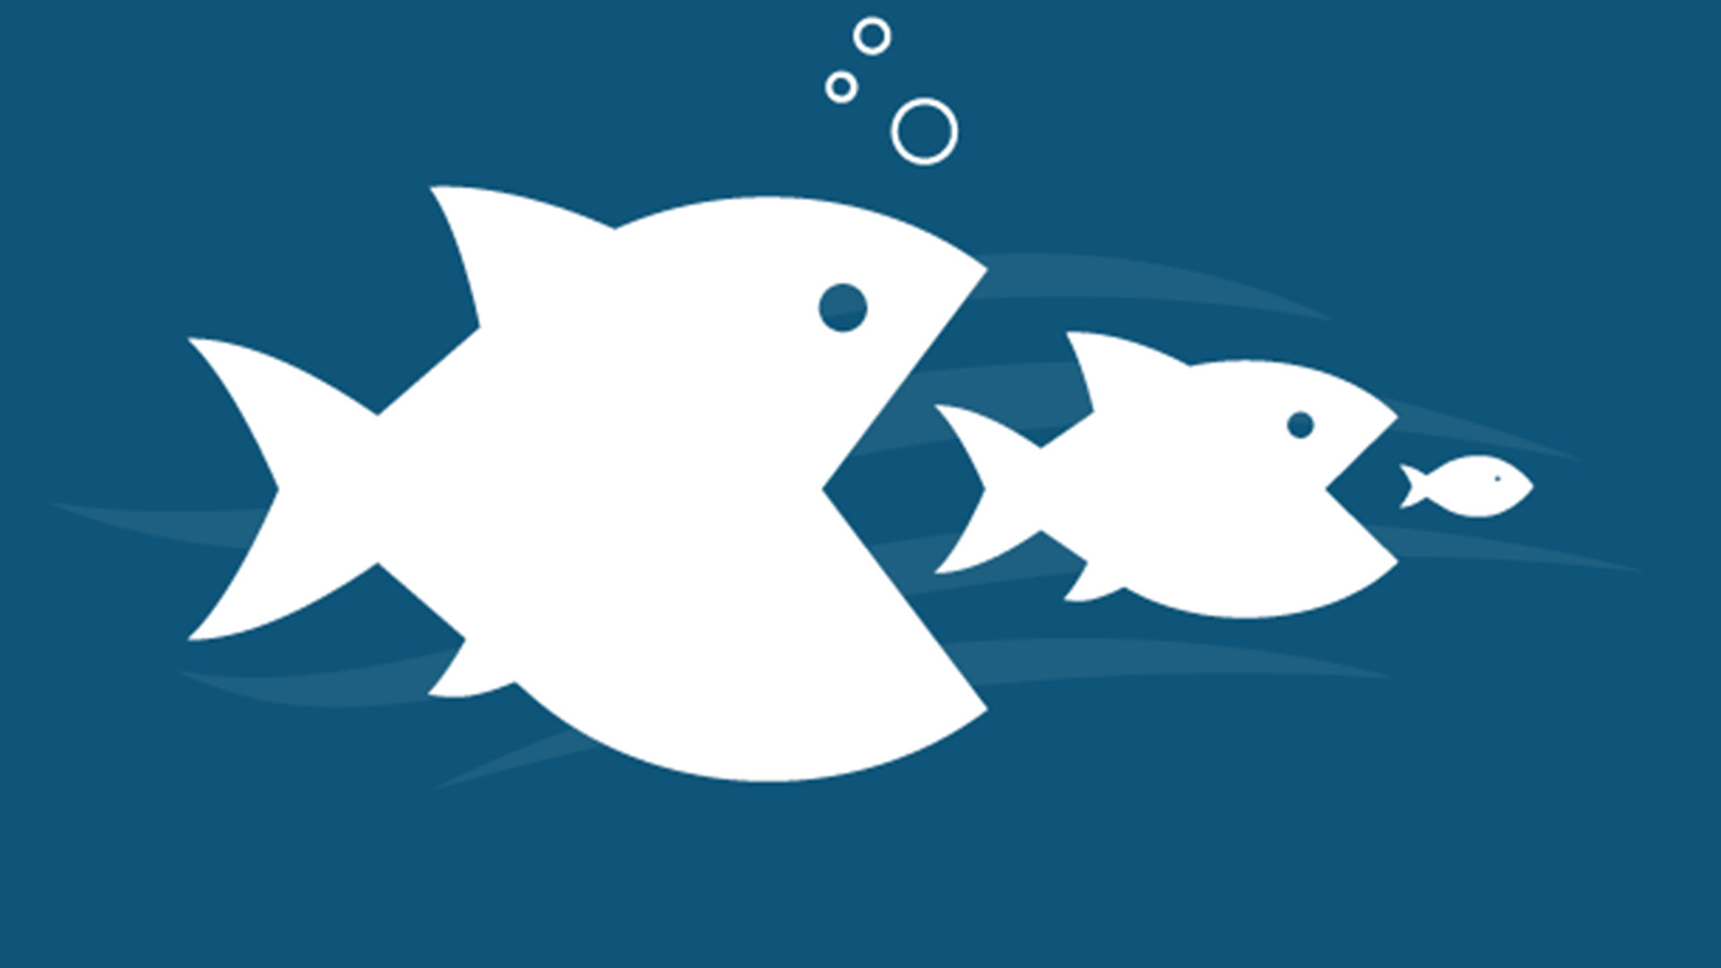
Survival of the fittest
$$Fitness= \frac{Score + (Ball_Hits_Left + Ball_Hits_Right)×10 000 - Lost_Balls×50 000}{Game Duration}×mult,$$
$$where mult\left\{\begin{aligned}2: IF Ball_Hits_Left>0 AND Ball_Hits_Right > 0 \\ 1: Otherwise\end{aligned}\right.$$

Slide 10

Cross-Over Techniques
Layer Shuffle
Weight Average
OR
def crossover_shuffle(self, parents: [NeuralNetwork]):
n_of_parents = len(parents)
child = copy.deepcopy(parents[0])
n_of_layers = len(child.layers)
parent_id = 0
for i in range(n_of_layers):
parent_id = i % n_of_parents
child.layers[i] = parents[parent_id].layers[i]
parent_id += 1
return child
def crossover_average(self, parents: [NeuralNetwork]):
n_of_parents = len(parents)
child = copy.deepcopy(parents[0])
n_of_layers = len(child.layers)
for i in range(n_of_layers):
avg_layer_weights=np.zeros(
np.shape(parents[0].layers[i].synaptic_weights)
)
for j in range(n_of_parents):
avg_layer_weights += np.array(
parents[j].layers[i].synaptic_weights
)
avg_layer_weights = avg_layer_weights / n_of_parents
child.layers[i].synaptic_weights = avg_layer_weights
return child

Slide 11

Mutation Techniques
Given a Mutation probability: $$p_{m}$$ (ex. 9%)
Offset
$$Weight=Weight+offset$$
$$offset ∈ [-0.1, 0.1]$$
Offset probability: $$\frac{p_{m}}{3}$$
Scale
$$Weight=Weight×scale$$
$$scale ∈ [0.9, 1.1]$$
Scale probability: $$\frac{2×p_{m}}{3}$$
def mutate(self, child, prob_mut):
mutant = copy.deepcopy(child)
for idx, layer in enumerate(child.layers):
for idy, weights in enumerate(layer.synaptic_weights):
for idz, weight in enumerate(weights):
random_number = random.random()
if random_number < (prob_mut / 3):
mutant.layers[idx].synaptic_weights[idy][idz] += random.uniform(-1, 1) / 10
elif random_number < prob_mut:
mutant.layers[idx].synaptic_weights[idy][idz] *= 1 + random.uniform(-1, 1) / 10
return mutant

Slide 12
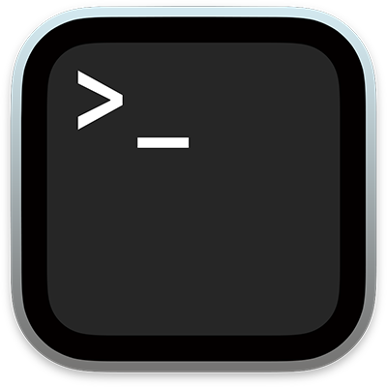
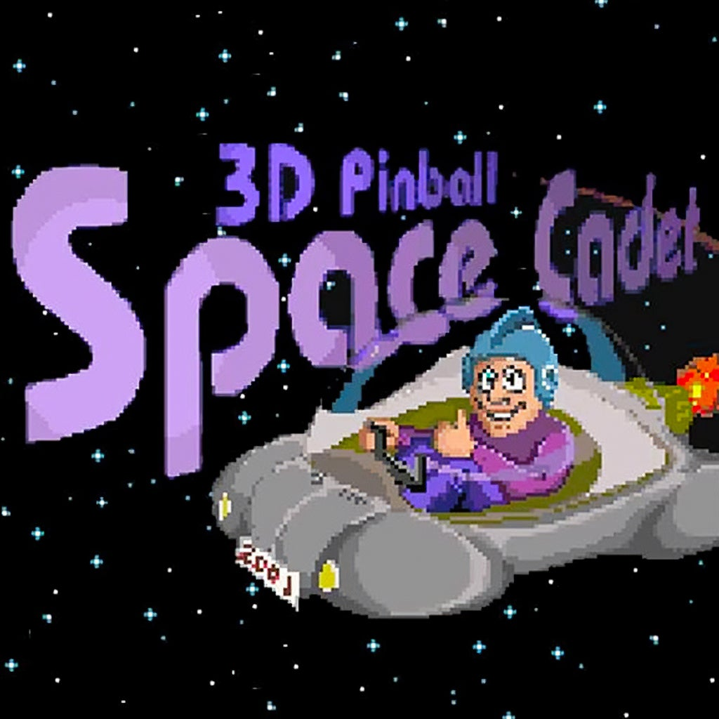
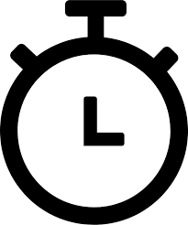
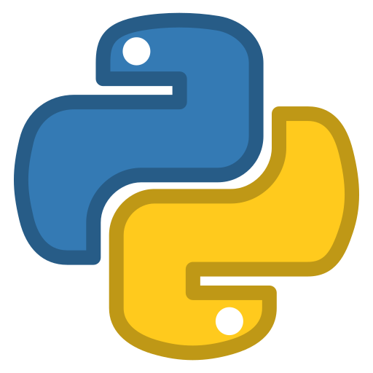
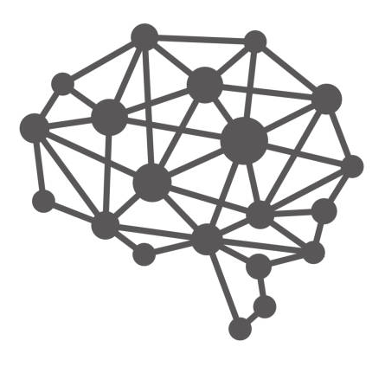


Game with Player Integration
Read IO Thread
Player 1 Thread
Write IO Thread
Main
...
Main
Fitness
Main
Cross-Over
Main
Mutation
Read IO Thread
Player N Thread
Save data
Write IO Thread
Calculate Game Duration
Repeat

Slide 13
Player/Game STDIO
Write IO Thread
Read IO Thread

Slide 14
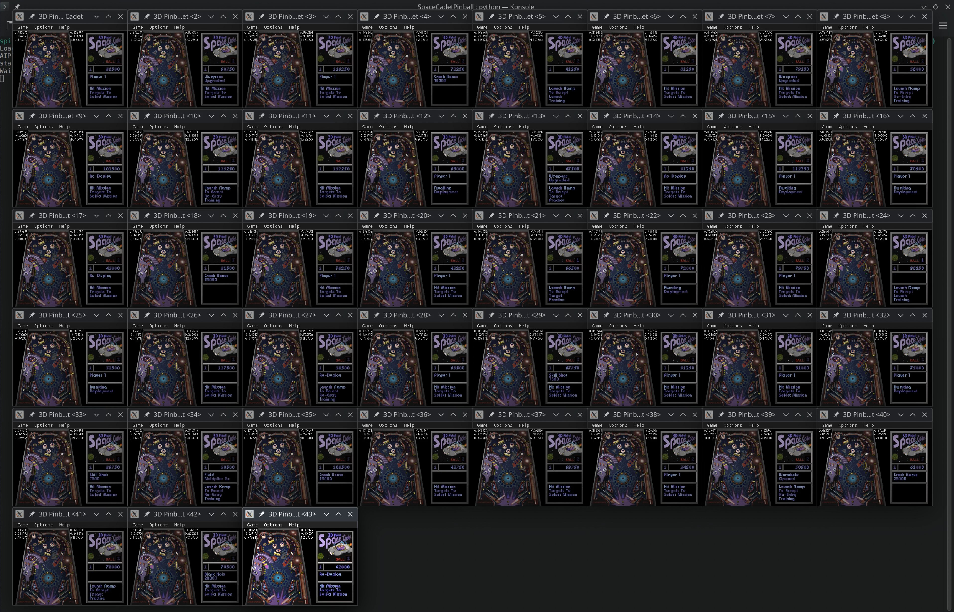
Live trAIning in action...
->link

Slide 15
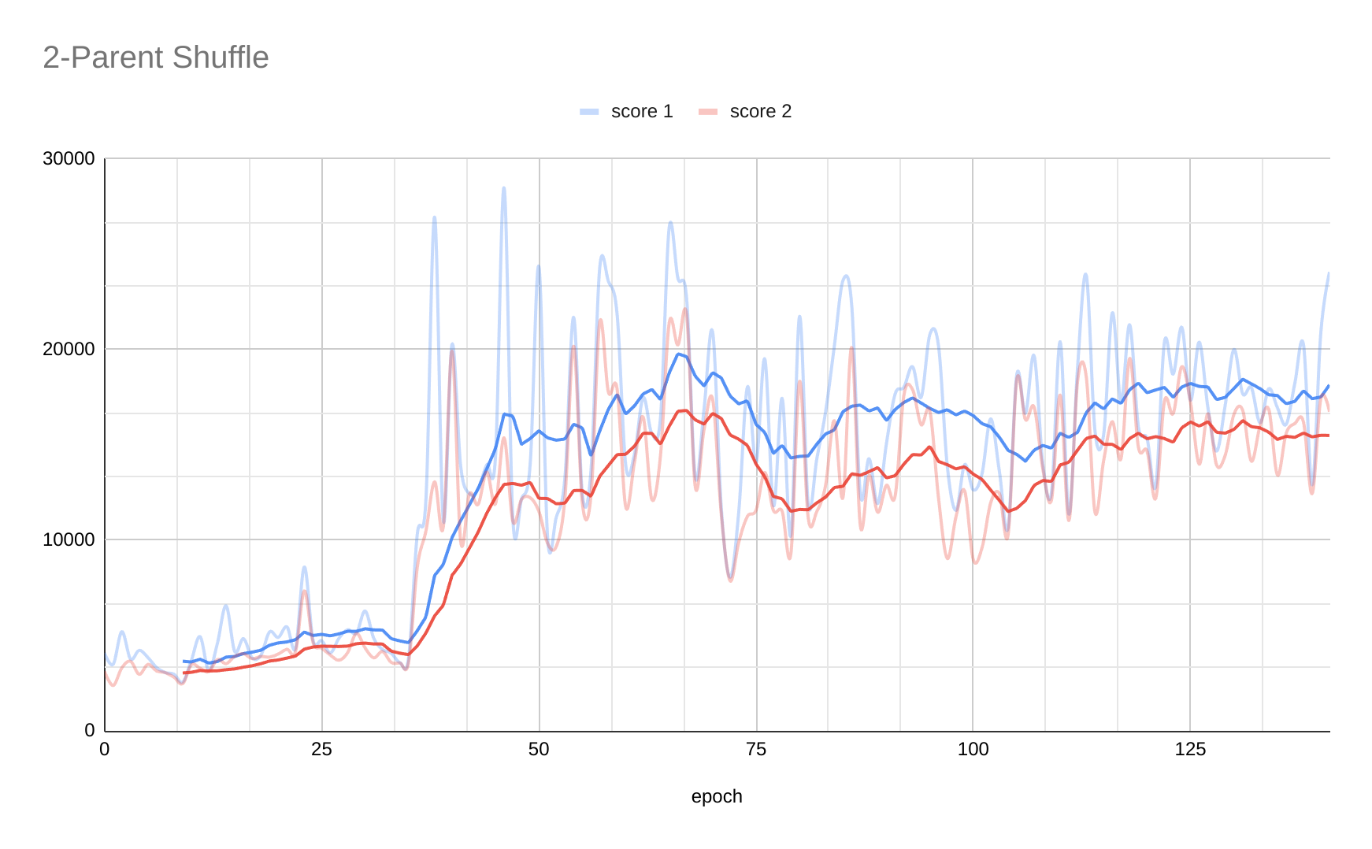
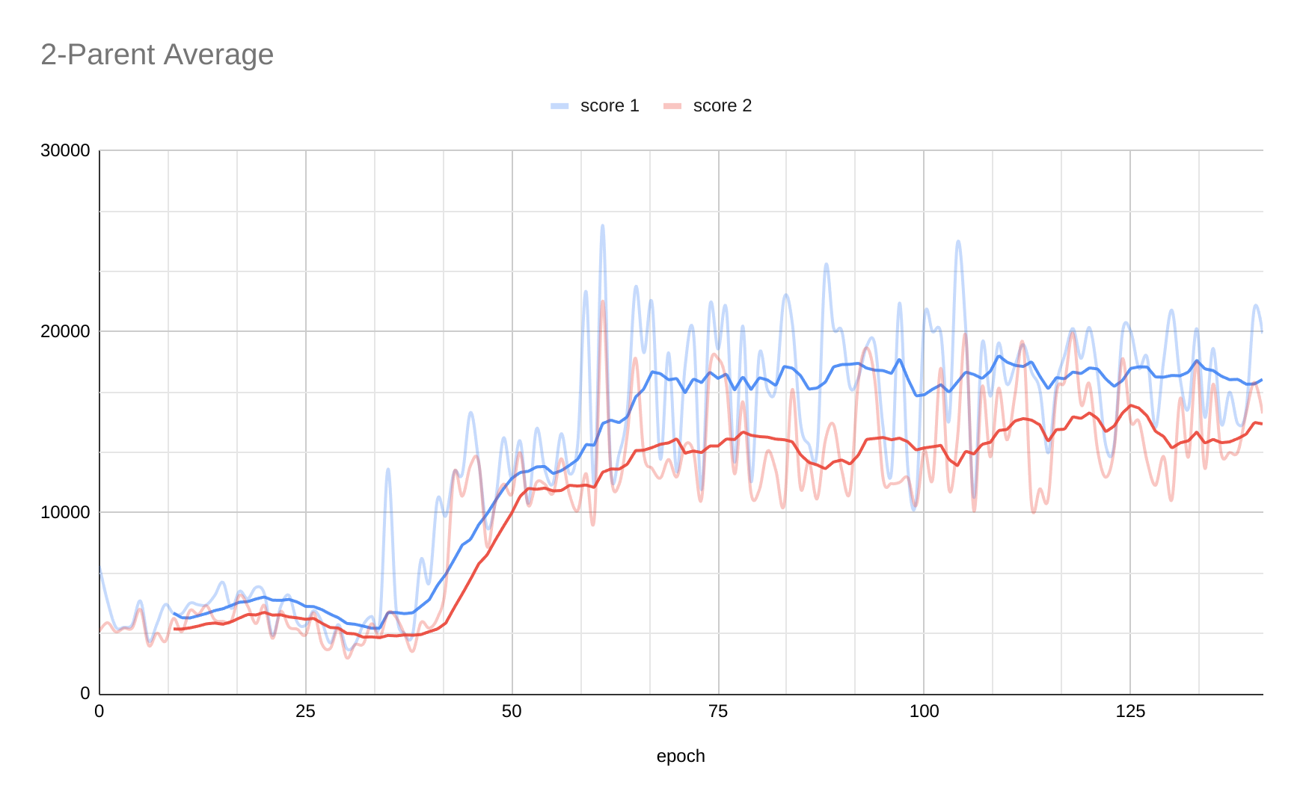
2-Parents | Shuffle/AVG | 3% Offset | 6% Scale
#Parents | Crossover | Mutation | Mutation

Slide 16
1-Parent | N/A | 3% Offset | 6% Scale
#Parents | Crossover | Mutation | Mutation

Slide 17
Crossover Comparison

Slide 18
Insights and Results
NeuroEvolution is slow
Spawning a few random NNs at every epoch helps in the beginning
Cross-over function can be very complex to design and predict
Go easy on mutations
No crossover and only mutations (k=1) also leads to capable NNs

Slide 19
Thank you
Questions?
Spiros Bontomitsidis
L-IN | E-M
May 31st ‘24

Slide 20
References/Links
Space Cadet port: k4zmu2a/SpaceCadetPinball
Library for Neural Network Visualization: jzliu-100/visualize-neural-network
Multilinear NN example: miloharper/multi-layer-neural-network
Genetic Algorithm for optimizing a NN: luaffjk/ga-mlp
Neuroevolution of augmenting topologies

